Slide 1
UNIVERSITY OF ALBERTA
ELECTRICAL AND COMPUTER ENGINEERING
Job recommendations for GitHub user based on location and their programming languages
Project Presentation
ECE 720
Social Network Analysis
Presented By:
Akhil Gonna (1610658)
Ravali Varanasi (1610598)
Professor: Ali Sajedi

Slide 2
OUTLINE:
Introduction
Approach
Workflow
Applications & Drawbacks
Validations
Conclusion
Demo

Slide 3

Introduction: GitHub
GitHub is an American company that provides hosting for software development version control using Git.
It provides access control and several collaboration features such as bug tracking, feature requests, task management, and wikis for every project.
Based on info in 2015: 9 Million Developers; 21.1 Million Repositories

Slide 4
Goal
To recommend jobs from Stack overflow based on the location and user’s programming language.

Slide 5
Approach
Our approach is more likely an interactive one, by taking some inputs from the user.
Fetching the user information by using GitHub API.
Collecting all the repositories and analysing on them.
Plot is drawn for the languages used in the repositories.
Based on the languages analysis and location of the user, data from stack overflow is fetched using beautiful soup.
We are taking a dataset having 5700 entries with tags, we are going to rank them based on the tag match and display top 50 jobs.

Slide 6
Process
Step 1: Fetching user details using GitHub API’s
Step 2: Analysis on the repositories and the tags of the repositories.
Step 3: Fetching jobs from Stack Overflow using location and languages used.
Step 4: Based on the skillset of the user we rank the jobs of the dataset and display them.

Slide 7

Application Programming Interface (API):
An application program interface (API) is a set of routines, protocols, and tools for building software applications.
Methods to access data and workflow from an application without using the application itself.

Slide 8
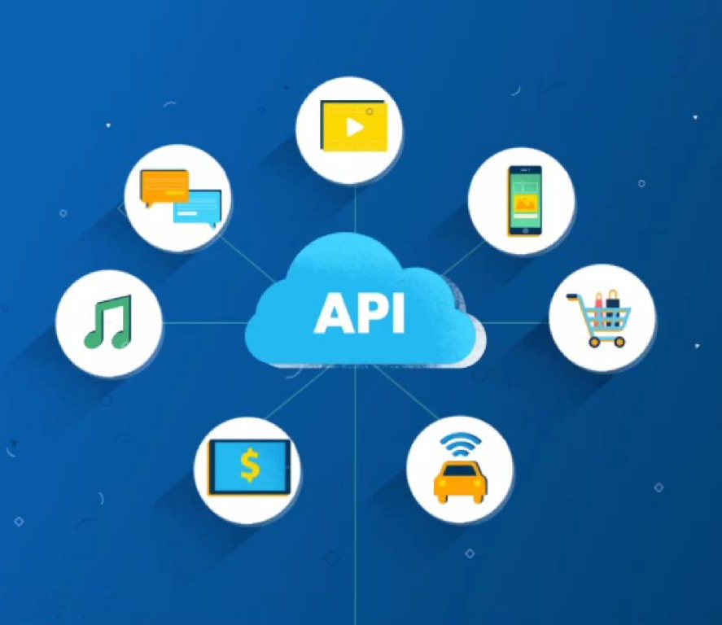
Why do we use API?
In building applications, an API simplifies programming by abstracting the underlying implementation and only exposing objects or actions the developer needs.
Each developer have different specifications and requirements on a specific application.
So, they can filter the extracted data and then analyse, process as per their needs.

Slide 9
GitHub API:
We used “REST API v3” to extract the data in json format.
All requests begin with: https://api.github.com
Throttling limit for this API is 5000/hour.
We have good documentation on GitHub API: https://developer.github.com/v3/

Slide 10

Beautiful Soup:
Beautiful Soup is a Python library for pulling data out of HTML and XML files.
It works with your favorite parser to provide idiomatic ways of navigating, searching, and modifying the parse tree

Slide 11
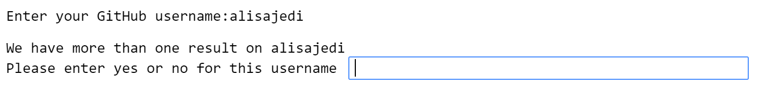
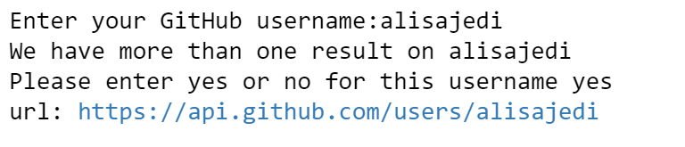
Work flow:
Initially, We request user to enter their GitHub username.
After the user’s input, we check the number of users. If there are more than one result, we ask to confirm the user name.
Once the user confirms the username, we fetch the data using https://api.github.com/users/ API

Slide 12
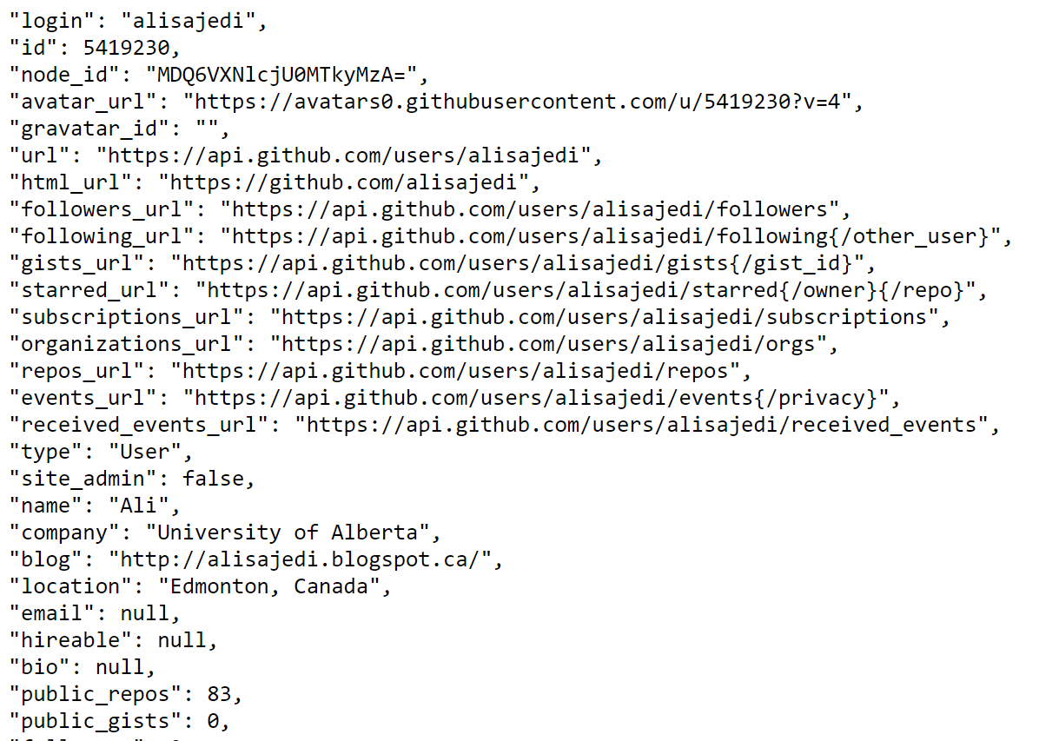
Workflow (Cont.)
We concentrate mainly on Repository URL of the user.

Slide 13
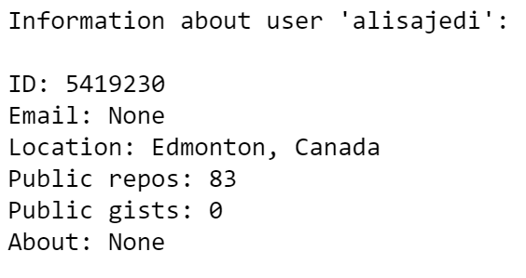
Workflow (Cont.)
We display some general information fetched:
We fetch all the repositories information using https://api.github.com/users/alisajedi/repos API

Slide 14
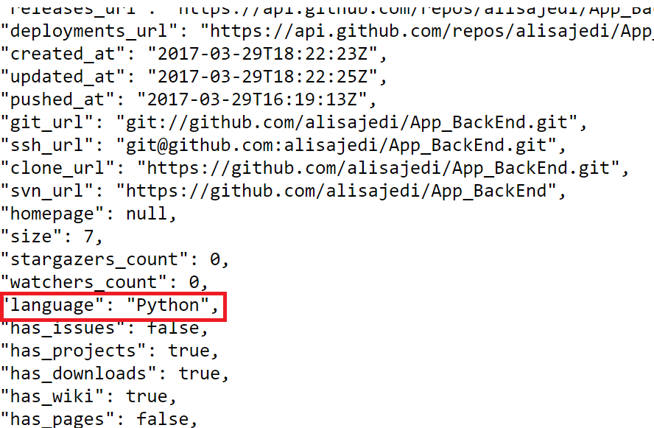
Workflow (Cont.)
From the data from repository URL we fetch the languages used.

Slide 15
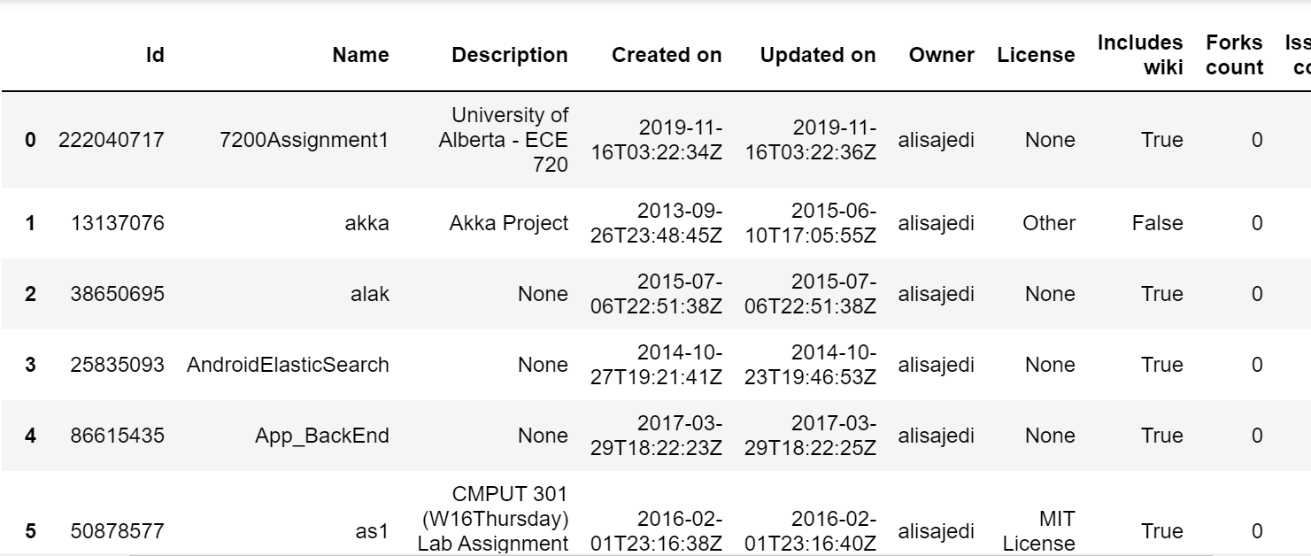
Workflow (Cont.)
We display the repository information of the user and export the data into csv format:

Slide 16
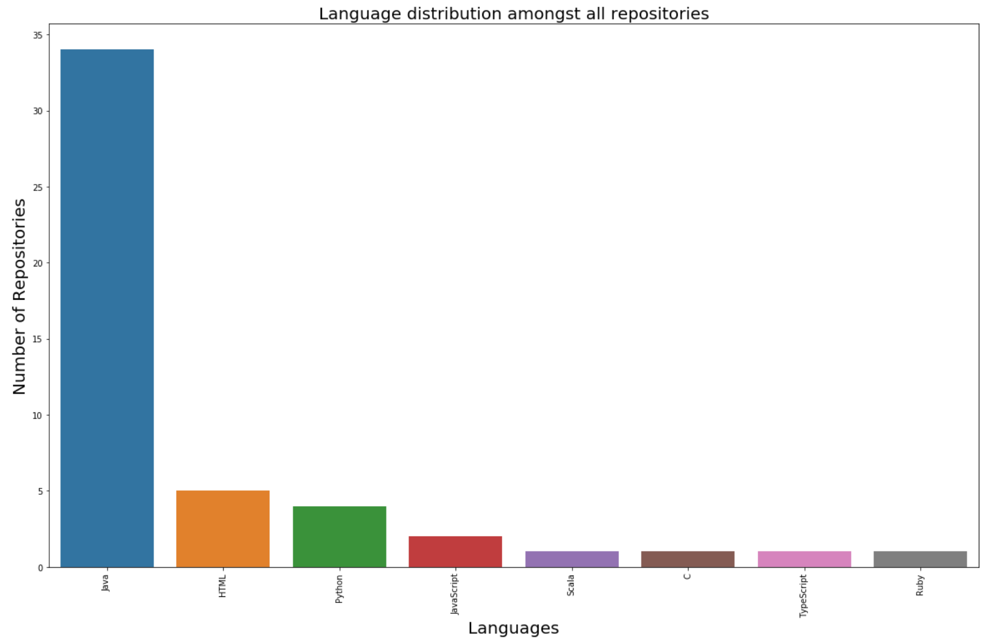
Workflow (Cont.):
We analyse and calculate the number of tags used we normalize and rank the tags.

Slide 17
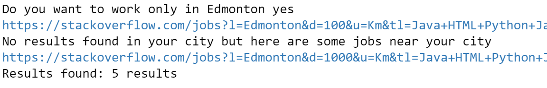
Workflow (Cont.)
Based on all the tags used and location of the user, we are scrapping jobs from Stack Overflow jobs website using beautiful soup.
In this step we ask user whether he only wants to work at his location. If yes, we fetch only jobs from his location or we fetch all jobs based on the tags used.
In this case I have given yes, then the results are:

Slide 18
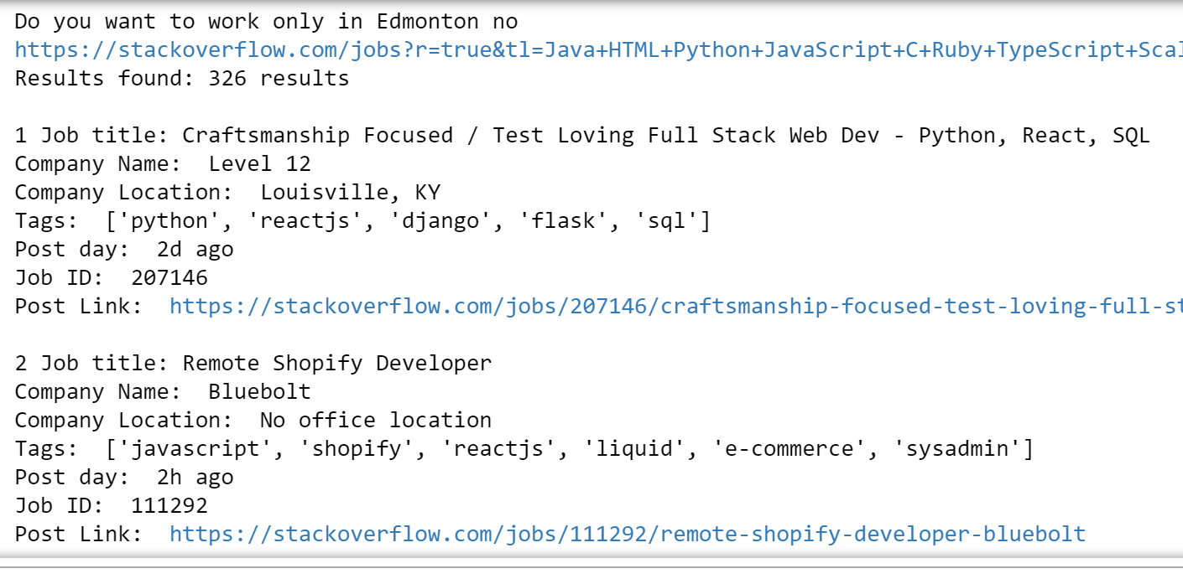
Workflow (Cont.)
If we give no then we get the results from other locations having remote jobs.

Slide 19

Workflow (Cont.)
We also imported a data set having (5700) entries which is taken from “Kaggle” website and try to rank them based the language experience of the user.
Initially we have taken all the languages used by the user based on number of usages of language.
Then we check the number of matches from the job tags to the user skills.
For example let’s consider an entry tag.

Slide 20
Workflow (Cont.)
Calculation of rank:
User Skills:
Job requirement(tags):
We calculate rank by using this formula:
Rank = Number of matches / Total number of tags in the job requirement.
For above example:
Rank = 2/4 = 0.5

Slide 21
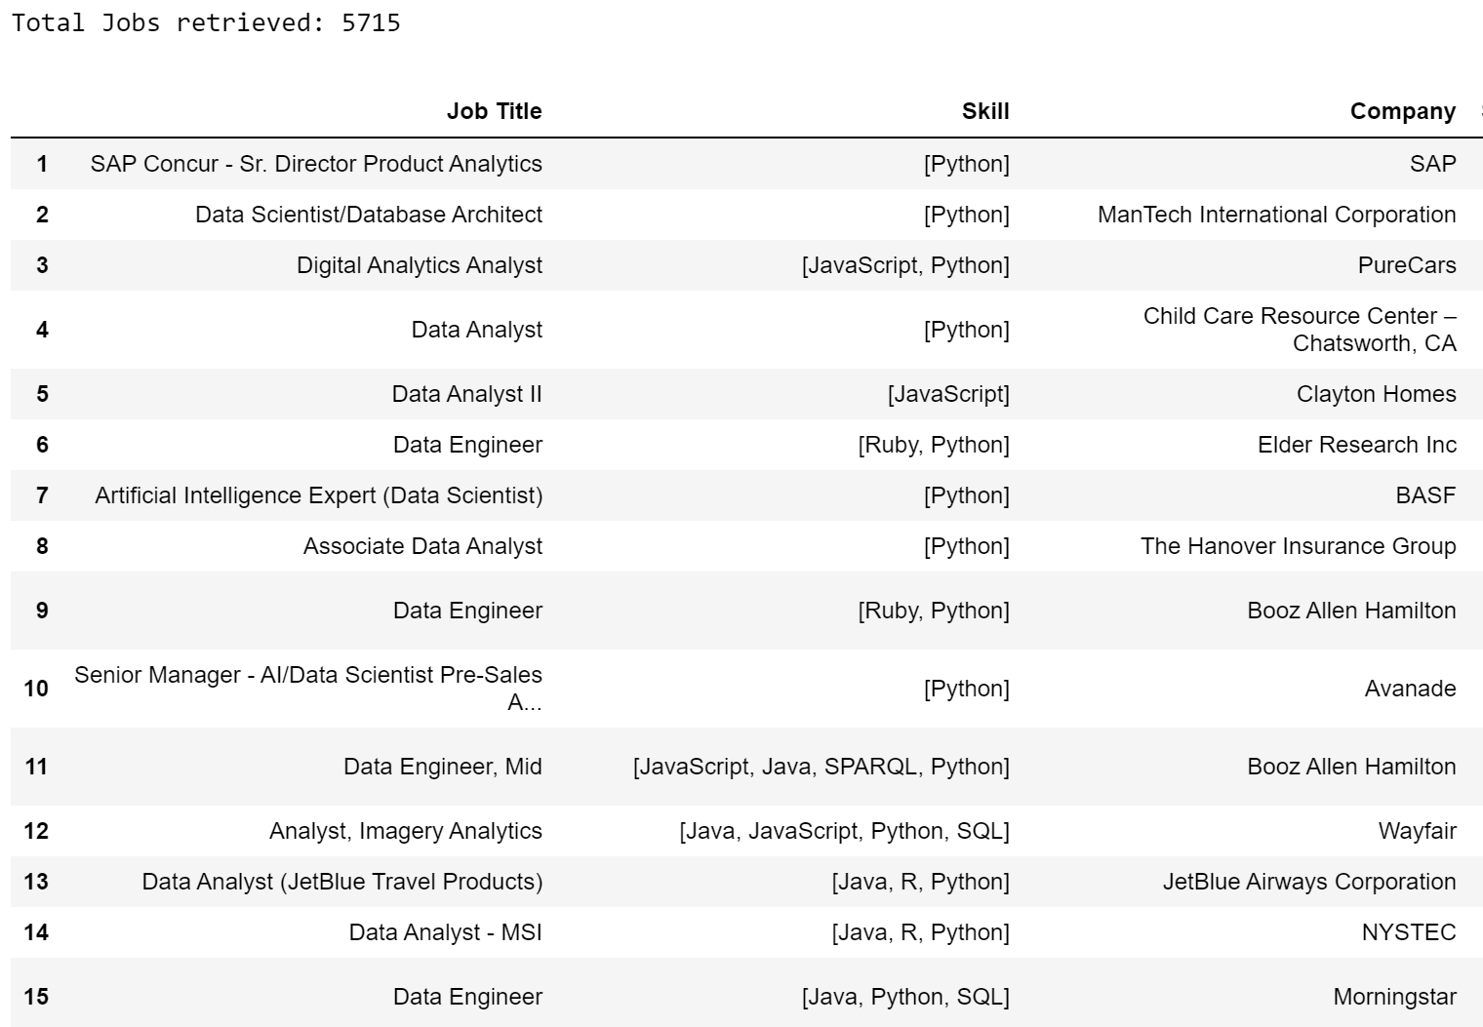
Workflow (Cont.)
Therefore by using the rank of each entry we fetch top 50 jobs and display to the user.
21

Slide 22
Demo

Slide 23
Applications
User skill Analysis.
Comparison between two users can be accomplished.
Automation of selecting experienced individuals based on GitHub repositories.

Slide 24
Drawbacks
We are not considering the quality of the repositories.
Popularity of the user is not considered.
As we use GitHub API, we have limit of 5000 requests/hour.

Slide 25
Validation
Jobs scrapped from Stack Overflow:
We manually search jobs based on the skill set and compare.
We have evaluated and one profile and checked whether the recommendations are useful to the user.
Jobs from the dataset:
We manually tested for first hundred entries and ranked based on our formula and the output as expected.

Slide 26
Conclusions
User repository analysis can be obtained.
Job recommendation based on the location and language experience from Stack Overflow jobs are obtained.
Ranking jobs from the dataset having skill tags are obtained.

Slide 27
Future work
We try to include the quality of the repositories of the user and improve the rank of the skills.
We try to scrap jobs from two or more websites and rank the jobs and recommend.
We try create skill tags for indeed jobs and rank them based on the skills.
Improving the rank of the jobs from the dataset by adding extra factors like rating of company, age of the post, salary .. Etc.
Finally we try to create an open source application which helps users and employers to identify their potential jobs based on the GitHub experience.

Slide 28
References
Google Images
GitHub API Documentation “https://developer.github.com/v3/”
Beautiful Soup Documentation “https://www.crummy.com/software/BeautifulSoup/bs3/documentation.html”
Dataset from Kaggle “https://www.kaggle.com/datasets”
K. Aggarwal, A. Hindle, and E. Stroulia. Co-evolution of project documentation and popularity within GitHub. In 11st Working Conference on Mining Software Repositories (MSR), pages 360{363, 2014.

Slide 29


